Slide 1
RETAIL DATA ANALYTICS PRESENTATION
BY LOGINWORKS SOFTWARES

Slide 2
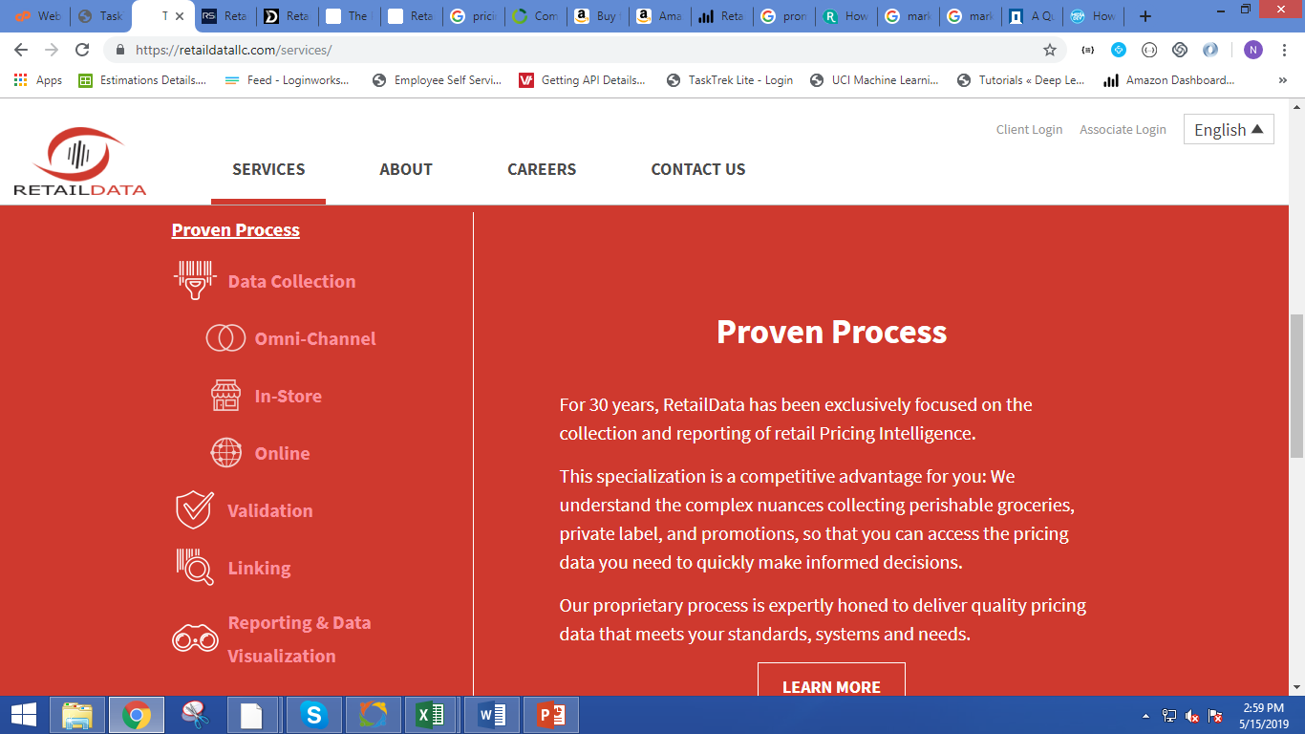
RETAILDATA SERVICES

Slide 3
Values we can provide them
Spatial Analytics
Technology Integration
Predictive Analysis - to help retailers create more loyal customers, predict the success of future promotions, and increase revenue.
Big Data Analytics
Embedded Analytics
Social Media Analytics
Sentiment Analysis : Based on customer reviews
Data Quality Management
Dark Data
Smarter Chatbots
Machine Learning
Augmented analytics
Data fabric
NLP/ conversational analytics

Slide 4
Value for Brands
Demo Service to target low level vendors ,therefore, increasing the retail customers.
Returns – providing profit
Artificial Intelligence
Provide Offers like discounts to low level vendors ,which may attract them.
Video Analytics
Predicting Customer Expectations
Store Visitor Insights Data
Provide in - store display analysis
Predict Behaviour
Artificial Intelligence
NLP/ conversational analytics

Slide 5
Value for Brands
Deep learning
Blockchain
Hadoop
Deep neural networks
ML libraries
Actionable analytics
Self-Service BI Interfaces
Cloud-first strategy
Deep Learning

Slide 6
Value for Brands
DataOps data analytics

Slide 7
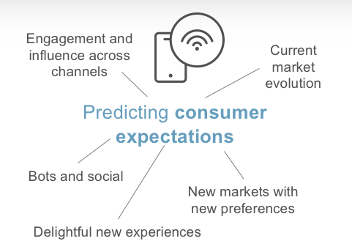
Solutions
Predicting Consumer Expectations
Store Visitor Insights Data
It generally tell us about the store with the maximum number of visitors.
We can use the Places Patterns in an aggregation of visits to the places that can help unlock key insights about the business.
We can also find that what times of day/week do people visit this place

Slide 8
Sentiment Analysis
Social Media Analytics
We can find the sentiment analysis from the data like how much the user likes the store according to the review.
Sentiment analysis refers to the use of natural language processing, text analysis, computational linguistics, and biometrics to systematically identify, extract, quantify, and study affective states and subjective information.
Social media analytics is the process of gathering data from stakeholder conversations on digital media and processing into structured insights leading to more information-driven business decisions and increased customer centrality for brands and businesses.
This allows enterprises to extract information about how the public perceives their brand, what kind of products consumers like and dislike and generally where markets are going. .

Slide 9
Embedded analytics
Spatial analysis
Embedded analytics is the integration of analytic content and capabilities within business process applications.
It provides relevant information and analytical tools designed for the task at hand so users can work smarter and more efficiently in the applications they use every day.
Spatial analysis or spatial statistics includes any of the formal techniques which study entities using their topological, geometric, or geographic properties.
In a more restricted sense, spatial analysis is the technique applied to structures at the human scale, most notably in the analysis of geographic data.

Slide 10
Big data analytics
Demo Services
Video analytics
Big data analytics is a form of advanced analytics, which involves complex applications with elements such as predictive models, statistical algorithms and what-if analysis powered by high-performance analytics systems.
Big data analytics offers various business benefits, including new revenue opportunities, more effective marketing, better customer service, improved operational efficiency and competitive advantages over rivals.
Demo Service can be used to target low level vendors. Therefore, increasing the retail customers.
We can offer returns to the lower level vendor so that they can get interested in our services .
Also giving some discounts to the needful vendors will lead to retailers loyalty.
Video analytics generally find out the video sentimental analysis.
we can use python language to find the sentimental analysis for the video using the video recording module.
We can also find the text from the video using the python.

Slide 11
COMPETITORS

Slide 12


